Slide 1





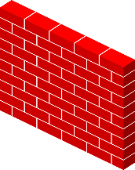
2.1 High level component and their interactions
Client
Network
Travlendar+ DB
Mobile Interface
Logic Application
Firewall
Database Server
External DB
The 2-tier architecture develops in the best way our project ideas: all logical operation regarding to app functionalities
are computed in the client part, instead the data are securely preserved in databases, accessible through the database
server.
The logic application needs this data to work properly, so it requests them from the database server in which there all
database which contain the data needed.
Between client and server we provide more security through a firewall

Slide 2
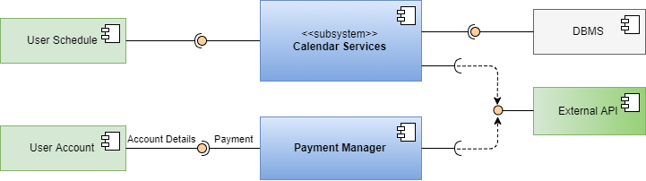
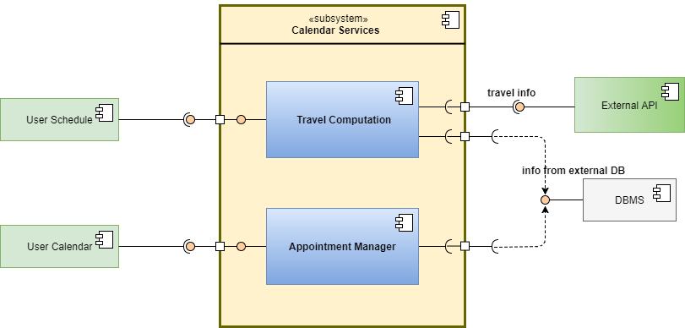
2.2 Component view

Slide 3


Remote Data Access
Server
Data
Client
Server
Dbms
Network
Mobile Interface
Application
External DB
Travlendar+ DB
Travlendar+ Server

